Slide 1
Bivariate distributions

Slide 2
A bivariate distribution: brief introduction
A bivariate distribution is the probability distribution of two random variables.
Examples:
A NTU student’s height and weight
A company’s profit and size
A patients’ heart rate and blood pressure

Slide 3

RV #1 + RV #2 = a bivariate distribution?
The bivariate distribution depends on how (much) the two RV‘s are related—an infinite number of possibilities.
E.g., NTU students’ heights and weights are related in a different way than those of NUS students
So in general, we can’t somehow “combine” the two distributions to derive their bivariate distribution.

Slide 4
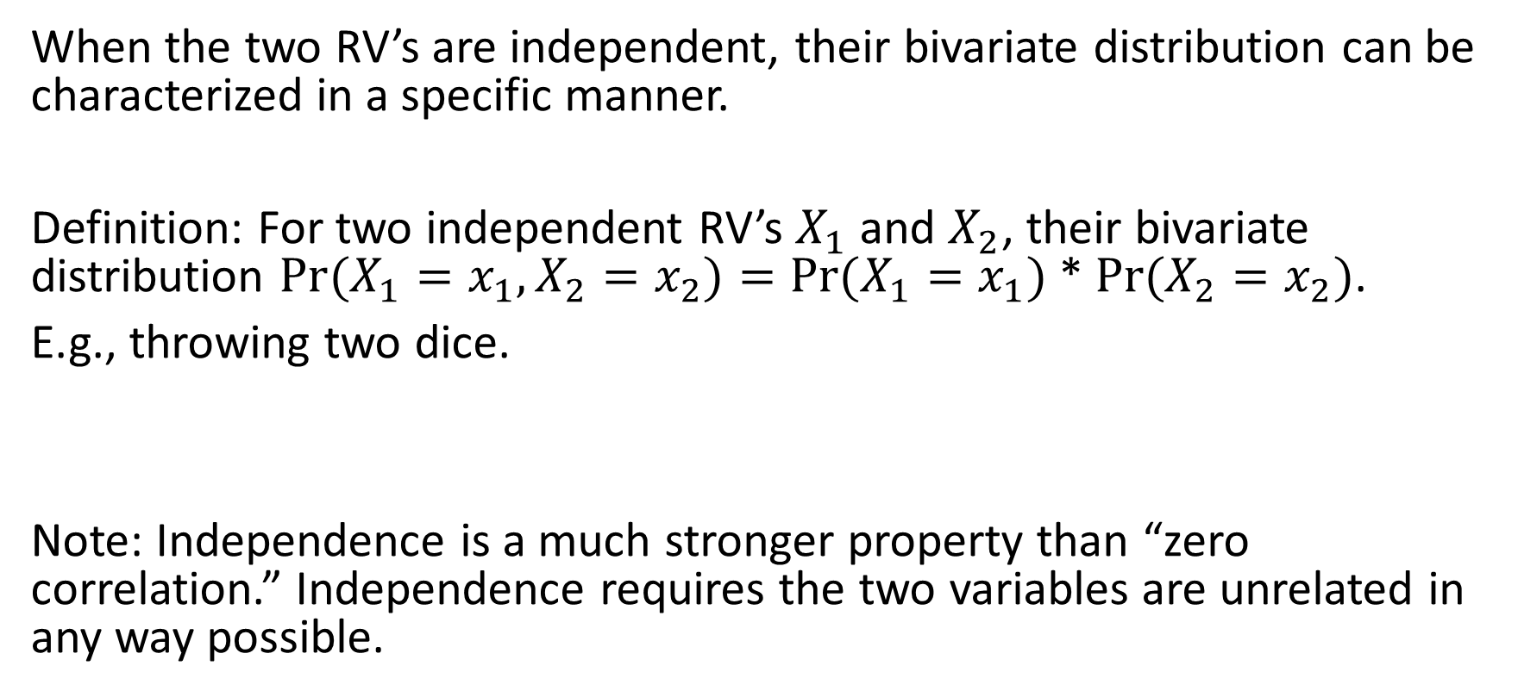
Independence of random variables
When the two RV’s are independent, their bivariate distribution can be characterized in a specific manner.
Definition: For two independent RV’s $X_{1}$ and $X_{2}$, their bivariate distribution $Pr⁡(X_{1}=x_{1},X_{2}=x_{2})=Pr⁡(X_{1}=x_{1})$ * $Pr⁡(X_{2}=x_{2})$.
E.g., throwing two dice.
Note: Independence is a much stronger property than “zero correlation.” Independence requires the two variables are unrelated in any way possible.

Slide 5
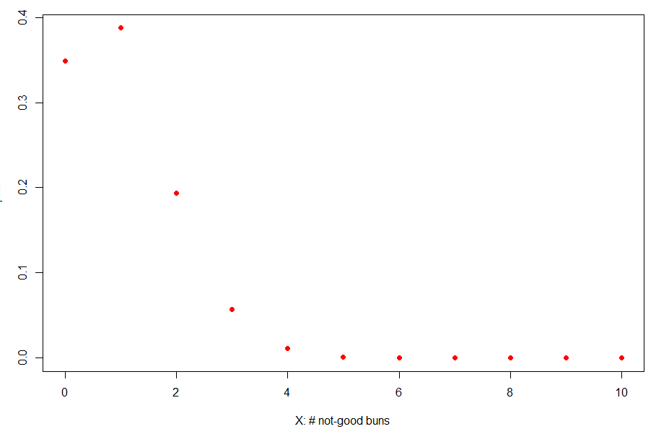
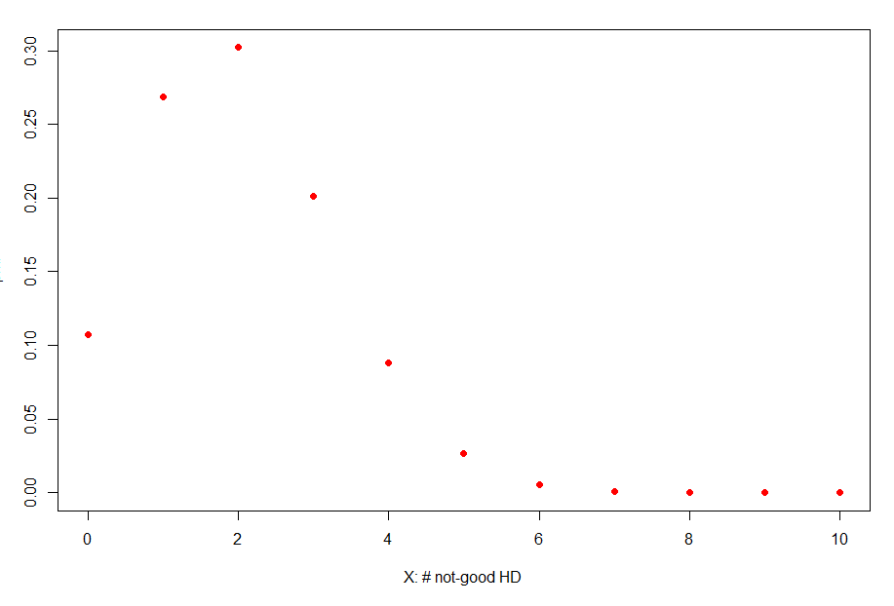

Example
A company producing hotdog buns took 10 of them to inspect their quality. Each consists of a “bun” and a “hotdog.”
The # buns not meeting the quality standard followed a binomial dist with 0.1 probability; and for the hotdog, the probability is 0.2.
plot(0:10,dbinom(0:10,10,0.1),col='red',pch=19)

Slide 6
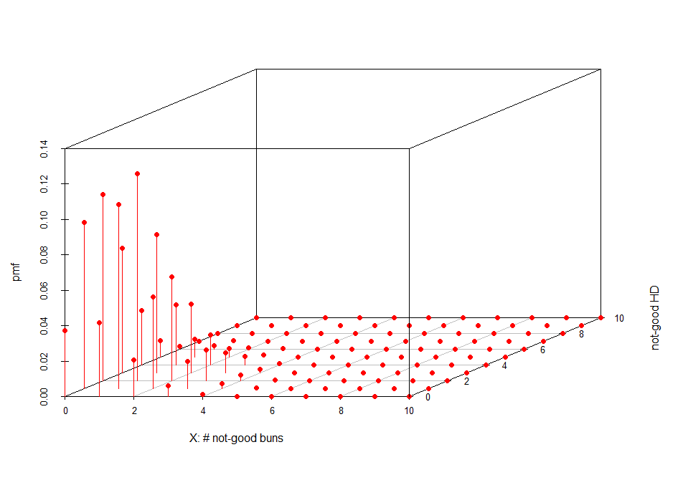

What is the probability distribution of the two RV’s?
-If they are not independent, then their bivariate distribution would depend on how and how much they are related.
-If the two variables are statistically independent, then $\operatorname{Pr}\left(X=x,Y=y\right)=\operatorname{Pr}\left(X=x\right)∗Pr⁡(Y=y)$
E.g., $\operatorname{Pr}\left(Bad buns=1,Bad hotdog=2\right)=$ $\operatorname{Pr}\left(Bad buns=1)∗Pr⁡(Bad hotdog=2\right)=$0.1169971
A bivariate distribution is the probability of observing the two RV taking certain values
But ….in practice, X and Y can be related in many different ways and degree. Each level of relatedness will result in a different bivariate distribution
Created using scatterplot3d()

Slide 7
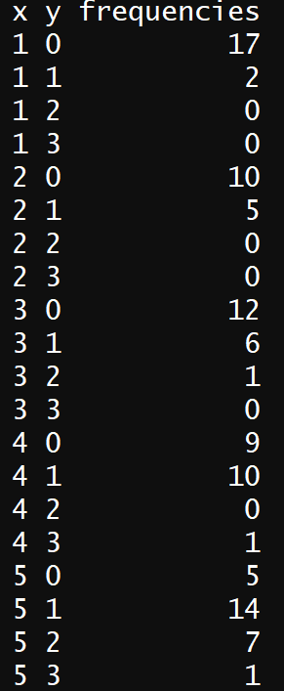
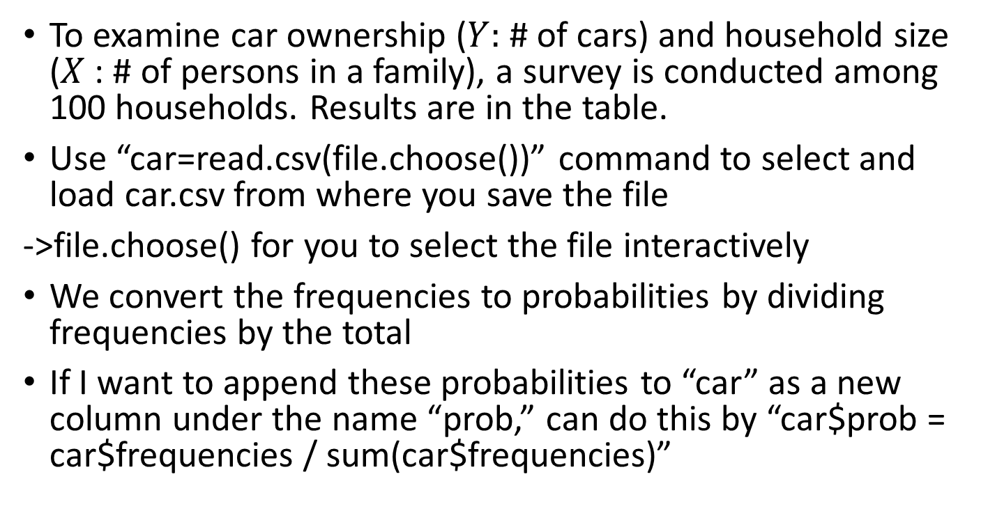
Loading a CSV file into R
Now you’ve learned
How to import an external csv data file into R
How to add columns to an existing dataframe
How to refer to a column and use the sum() function
To examine car ownership ($Y:$ # of cars) and household size ($X$: # of persons in a family), a survey is conducted among 100 households. Results are in the table.
Use “car=read.csv(file.choose())” command to select and load car.csv from where you save the file
->file.choose() for you to select the file interactively
We convert the frequencies to probabilities by dividing frequencies by the total
If I want to append these probabilities to “car” as a new column under the name “prob,” can do this by “car$prob = car$frequencies / sum(car$frequencies)”

Slide 8
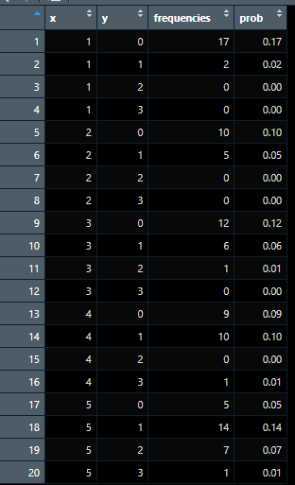

Marginal distributions
The distribution of a single RV $X$ or $Y$ are called the marginal distributions, in relation to their joint distribution for ($X$, $Y$)
We can generate marginal distribution of $X$ (or $Y$) by tabulating the probabilities of $X=x$ (or $Y=y)$ in the joint distribution

Slide 9
Marginal probability: Calculating conditional sum
## How do we calculate Pr(X=1)?
> sum(car$prob[car$x==1])
Car$prob: the column
Pr(X=1)
=sum of…
car: the entire table
car$x==1 by itself generates a True-False logical vector, where the positions satisfying the condition take “True” and “False” otherwise:
[True True True True False False…….]
Condition
Notes:
sum(car$prob[car$y==1])
0.37

Slide 10
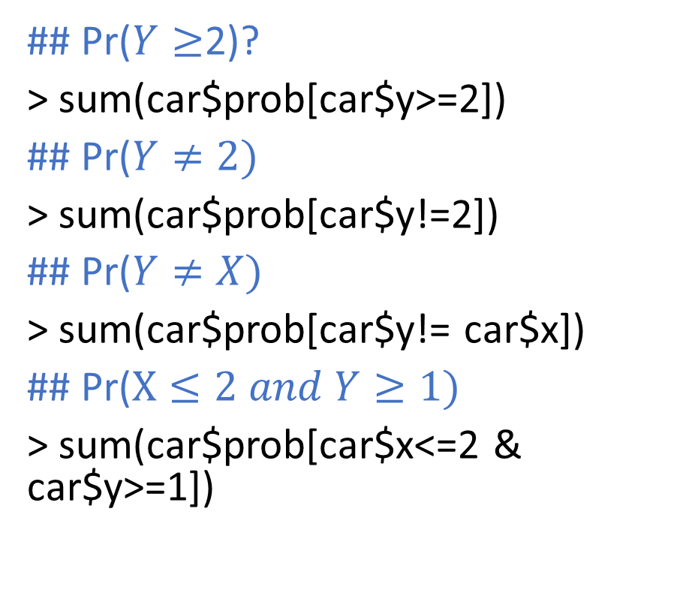
Logical Operators
Operator | Description
< | less than
<= | less than or equal to
> | greater than
>= | greater than or equal to
== | exactly equal to
!= | not equal to
x | y | x OR y
x & y | x AND y
## Pr($Y≥$2)?
> sum(car$prob[car$y>=2])
## Pr($Y≠2)$
> sum(car$prob[car$y!=2])
## Pr($Y≠X)$
> sum(car$prob[car$y!= car$x])
## Pr($X≤2 and Y≥1)$
> sum(car$prob[car$x<=2 & car$y>=1])

Slide 11
Summary
Bivariate and marginal distributions
R commands
How to load a csv file from the computer
How to append a column (with a name) to an existing data structure
How to calculate probabilities from a bivariate distribution (conditional sum)

